Slide 1

Autodock Installation

Slide 2
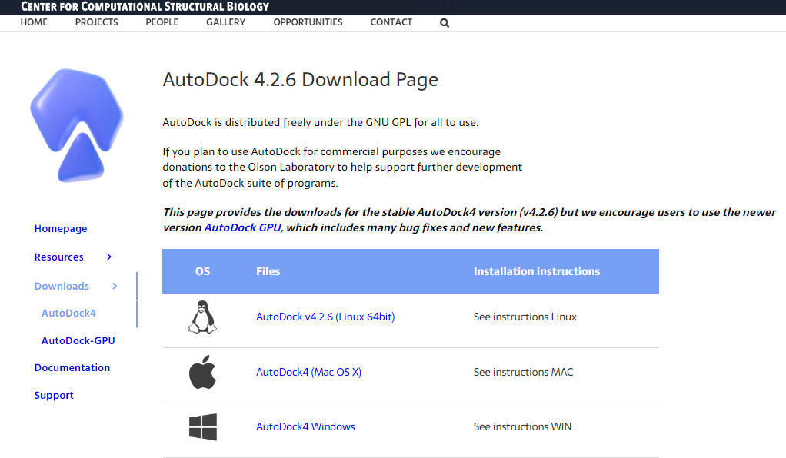
Downloading Autodock4
To download Autodock4 go to the following link
https://autodock.scripps.edu/download-autodock4/
Click this to download Autodock4 supported by Windows

Slide 3
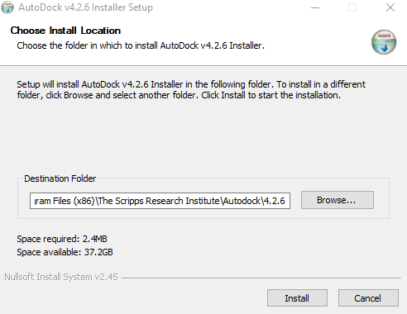
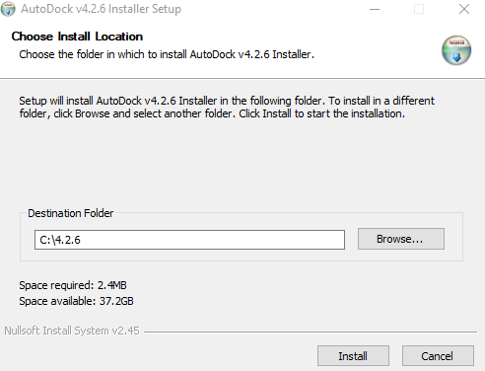
Installing Autodock4
Once the download completed, open the file (autodocksuite-4.2.6.i86Windows.exe)
Then click “Yes”
To change the installation folder Click “Browse” > Select “Computer” > Select Local Disk(C:) or OS(C:) > Then click “OK”
After that, the destination folder change to > C:\4.2.6
Now click “Install” > click “Close”
You have successfully installed the program files to run AutoGrid and AutoDock

Slide 4
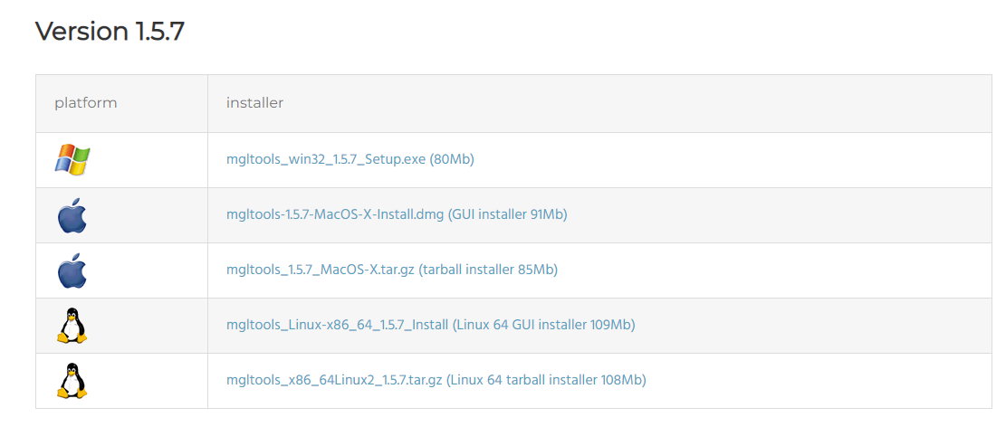
Downloading MGL Tools 1.5.7
To download MGL Tools 1.5.7 go to the following link
https://ccsb.scripps.edu/mgltools/downloads/
Click this to download MGL Tools 1.5.7 supported by Windows

Slide 5
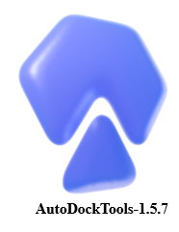
Installing MGL Tools 1.5.7
Once the download completed, open the file (mgltools_win32_1.5.7_Setup.exe)
Then click “Yes”
Once the MGL Tools installation wizard opened > click “Next” > click “ I accept the terms of the license agreement” > click “Yes” > click “Next”
Once the installation completes, a tab called “Commercial Usage” appears > now click “OK”
Now it shows “Installation Complete” > Unclick the “Lauch PMV” > finally click “Finish”
You have successfully installed the programs to visualize and prepare the docking files
AutoDockTools-1.5.7 Logo

Slide 6
Do’s and Don’ts
Don’ts
Don’t create the docking working directory at Desktop, Downloads, Documents
Don’t Use “Space” in folder name or file name
Example : cox2 docking, cox2 protein.pdb
Do’s
Always create the docking working directory at “Local DisK (C:) or OS (C:) or Local DisK (D:)”
Always use “_”(Underscore) instead of “Space” for folder name and file names while creating working directory
Example : cox2_docking, cox2_protein.pdb
Always copy the two AutoDock programs (autogrid4 & autodock4 from Local DisK (C:) or OS (C:) > 4.2.6 folder) file into your working directory

